Slide 1


Fiscal Year End 2026

Slide 2
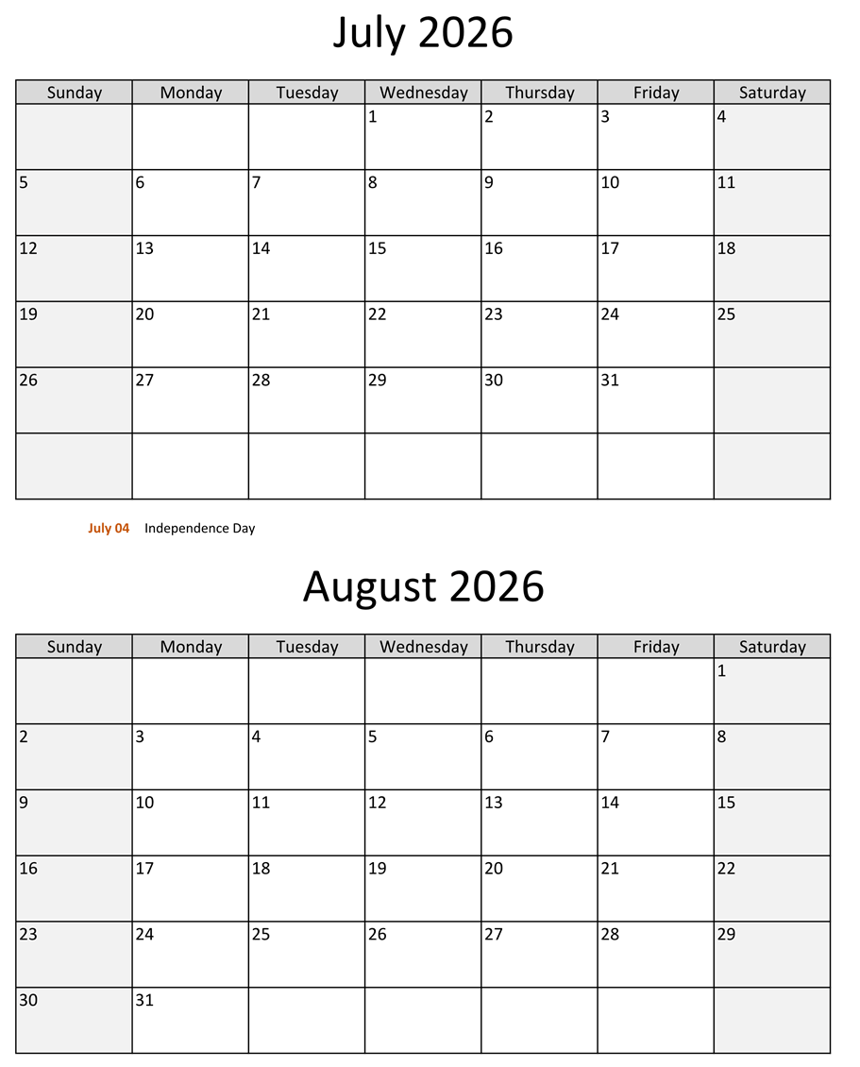
Office Coverage
Office coverage requires a Budget Authority and at least one staff member to process invoices, journal vouchers, purchase orders, and other related transactions.
If needed, a proxy must be identified and coordinated. If a proxy cannot be secured, contact F&A for support.

Slide 3
June Fiscal Year End Deadlines
June 1st
  Start writing the date goods or services are received on ALL invoices and receipts before processing, and continue through August 14th
June 12th – Send list of all departmental leases to F&A
June 18th – Last day to use PCard
June 26th – Last day to re-class PCard transactions in Banner
June 30th
  Deposit all cash/checks in Student Financial Services by 12:00pm
  Update all manual payroll checks by 5:00pm
  END OF FISCAL YEAR 2026

Slide 4
July Fiscal Year End Deadlines
July 1st
  Resume use of PCard, but only for FY27 purchases
  Review any deposits made in FY26 and notify F&A if any portion of that won’t be earned until FY27 (see unearned revenue slide)
  Email ap@eou.edu details for payments made in June where goods or services were not received by June 30th and continue through August 11th
July 6th
  Submit all FY26 invoices to AP by 12:00pm
  Notify AP of any prepaid expenses that were posted to FY26
July 8th
  Close out all encumbrances and purchase orders for FY26
  PERIOD 12 CLOSE

Slide 5
July Fiscal Year End Deadlines
July 9th
  Submit all June PCard packets to AP
  Notify AP if you see P-Card Transactions feed through for FY26
  Resume reclassing PCard transactions for FY27
  Email ap@eou.edu if any invoices received are for FY26 goods or services, continue until August 11th
July 14th
  Submit Library schedule for FY26 to F&A
  Notify F&A of any disposed assets in FY26 and any purchases that should have been capitalized over the year
  Notify F&A of any outstanding receivables (funds owed to your department for FY26 activity), including third party vendors
July 15th
  Notify F&A of any pledges received for gifts
July 24th – Submit Housing & Dining census data to F&A
July 27th – PERIOD 14 CLOSE

Slide 6
DISCOVER THE EASTERN EDGE
REVENUES

Slide 7
Cash Deposits
All cash and checks received by departments on-campus should always be deposited at Student Financial Services as soon as possible
Please try to avoid accumulating receipts for final deposit Do not hold deposits for FY26 until after June 30th
June 30th – Deposit all cash and checks received in your department at Student Financial Services by 12:00pm
July 1st – Review any deposits made in FY26 and notify F&A if any portion of that revenue won’t be earned until FY27
July 14th – Notify F&A of any outstanding receivables (funds owed to your department for FY26 activity)
July 15th – Notify F&A of any pledges received for gifts

Slide 8

Petty Cash & Long Term Change Funds
Please work with Accounts Payable to reconcile any outstanding petty cash funds and long term change funds from FY26
June 30th
Reconcile and deposit all cash receipts by 12:00pm
All petty cash funds should be fully reimbursed to the original amount of cash before being deposited by Student Financial Services
Submit all required documentation to AP

Slide 9
Unearned Revenues
Unearned Revenue – Payment received for goods or services which have not yet been provided (prepayment for goods or services that EOU is providing)
If you have cash or checks to deposit that might be classified as unearned revenue, please send an email with the details to ap@eou.edu when the deposit is made at Student Financial Services (this does not include tuition and fees or housing)
Prior to June 30th – Review deposits made over the last month or two and email ap@eou.edu if any portion of that revenue is considered unearned as of June 30th
June 30th – Deposit all cash/checks received at the Student Financial Services Office by 12:00pm

Slide 10
DISCOVER THE EASTERN EDGE
EXPENSES

Slide 11
Purchase Orders & Encumbrances
Each year, it is EOU’s process to close-out all purchase orders and encumbrances in Banner before rolling beginning General Ledger balances
Encumbrances – Athletics, Facilities, and Payroll are the only departments that currently utilize encumbrances. Payroll encumbrances will automatically close out after June 30th
Purchase Orders – Finance & Administration will send an email to any user with an open PO on July 1st
July 2nd
  Email ap@eou.edu if there are still outstanding invoices to be paid on these encumbrances or purchase orders
  Close out all encumbrances and purchase orders for FY26

Slide 12
Personal Service Agreements
ALL FY26 PSAs will effectively end on June 30th
If a contractor is providing services up to June 30th, please ask them to submit final invoices ASAP so that they can be paid in the correct fiscal year.
Contractors providing services on or after July 1st must be on a fully executed FY27 contract before services can be rendered. Fully executed means the completed contract is signed by all parties and proof of insurance has been submitted via the Contract Submission Form
FY27 PSA numbers are being issued, so please email ap@eou.edu for a contract number for any upcoming services.

Slide 13
Invoice & Journal Voucher Accruals
Accrual basis accounting requires expenditures to be charged to the fiscal year and period in which the goods are received or services are performed, regardless of when budget or cash is available.
Review all invoices for the following two scenarios that require additional action:
Scenario 1 – Prepaid:
Expenses for FY27 activities paid on or before 6/30/2026 – Email details to ap@eou.edu
Scenario 2 – Accrual:
Expenses for FY26 activities paid on or after 7/1/2026 – Email details to ap@eou.edu

Slide 14
Invoice & Journal Voucher Accruals
June 1st – Start writing the date goods or services were received on ALL invoices and receipts before sending to AP
July 6th – Submit all FY26 invoices to AP by 12:00pm
  Scan all invoices received after this date
    If goods or services were received before June 30th
      Enter in Banner with July transaction date, leave in-process, and send documents through Laserfiche, with note asking AP to complete. Note this is only for FY26 goods or services
    If goods or services were received July 1st or after
      Enter in Banner as a regular invoice with a FY27 (July 1 or later) transaction date.
    If you have only received part of the goods on the invoice, or you have only received a portion of the services
      Contact ap@eou.edu to determine correct procedures

Slide 15
Travel
June 30th- All EOU travel concluding on or before June 30th is considered an FY26 expense
June 24th- All advance repays for FY26 trips must be submitted, if trip has concluded
July 1st- All FY26 travel reimbursements are due to Accounts Payable
Itemized, final receipts are required for all reimbursable expenses.
Credit card statements or screenshots are NOT sufficient.
Hotel or rental car reservations are not acceptable in place of final receipts.
Receipts must clearly show:
        Vendor name
    Date of purchase/service
    Itemized charges
    Total amount paid
    Evidence that payment was charged/processed
Incomplete documentation may delay reimbursement processing or require additional follow-up.

Slide 16
Procurement Cards
Due to year-end processing deadlines, EOU will shut-off all Departmental Procurement Card feeds from June 27st through July 8th
Please plan accordingly to ensure no transactions are posted to the PCard during that period
June 1st – Review all invoices received from now through June 30th and notify AP of any payments for goods and services that are received after June 30th
June 18th – Last day to use PCard
June 26th – Last day to re-class PCard transactions in Banner
July 1st – Resume use of PCard, but only for FY27 purchases
July 9th – Submit all June PCard packets to AP

Slide 17
Transaction Descriptions
All Banner descriptions should be complete & include dates whenever possible.
Great Examples
Doodle subscription for IT 4/1/2026-3/30/2027
Conf Registration NACUBO M Kennedy April 2026
6 Copies of Training Book for Payroll “Payroll Boss”– to be shipped
6000 Tax Envelopes for SFS – to be shipped
Bad Examples
Registration
Fees
Training
Software
Supplies
<Will Be Returned For Corrections

Slide 18
Prepaid Expenses
Expenses for future fiscal years can be coded to the appropriate prepaid expense account code when entered in Banner.
If you have an invoice for prepaid expense, please follow the process below:
Enter invoice like normal and make note that it is a prepaid (FY27 expense)
At year end, budget authorities will see two JVs come through to move the expense from FY26 to FY27. The expense will be moved to A5002 (Prepaid Expense) in FY26 and moved to the appropriate expense account (2XXXX) in FY27. The adjusting JV will look like this:
FY26 Adjusting Journal Voucher:
  Notify AP of any prepaid expenses that have been paid through June 30th (i.e. airfare, hotel registration, conference registration, etc.)
Debit | Fund (tied to index) | A5002 | $100
Credit | Index | 2xxxx | $100

Slide 19
Leases and Capital Assets
Financial reporting requires that EOU analyzes all rentals and leases as capital or operating and report current and future liability to the University
If your department had lease or rental expense/revenue during FY26, or signed a lease for expenses/revenues in future years, please notify F&A
June 12th – Send list of all departmental leases to F&A
  Include vendor name, amount, lease start date, lease end date, and a copy of the lease (if not already in F&A)
  The most common leases at EOU are for space or equipment
Review budgets for purchases over $10,000 to ensure all assets that qualify have been capitalized in Banner
July 14th – Notify F&A of capital asset adjustments during FY26
  Send list of any assets that were disposed of during FY26, and a list of any purchases that should have been capitalized

Slide 20
Top 5 Year-End Reminders
Add as much detail as possible in Banner & documents
  Invoice commodities, deposits, P-Card, JV, document text and PO descriptions etc.
Deadlines matter
  Missing cutoffs can push transactions into the wrong fiscal year and create more work for your office as well as F&A.
Ensure your office has coverage
  Offices need Budget Authorities and document originators available especially during July and August. If you are not available as the primary point of contact, PLEASE designate a backup and make sure they are available. PLEASE also ensure backup approvers are in the Banner approval queues.
Submit everything early
  Invoices, deposits, and documentation should not wait until the last day.
Communicate with Finance & AP
  If something looks off (unearned revenue, missing invoices, etc.), flag it early.

Slide 21


Questions?

